Slide 1
1.27

Slide 2
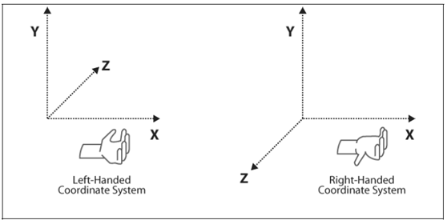
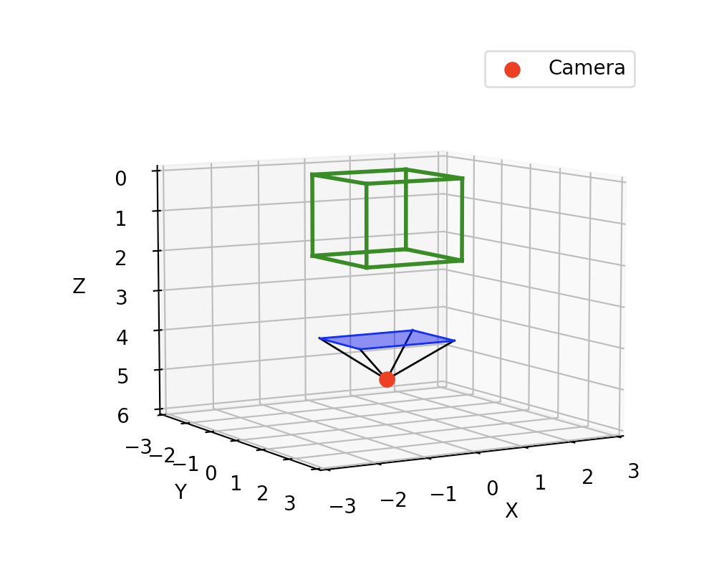
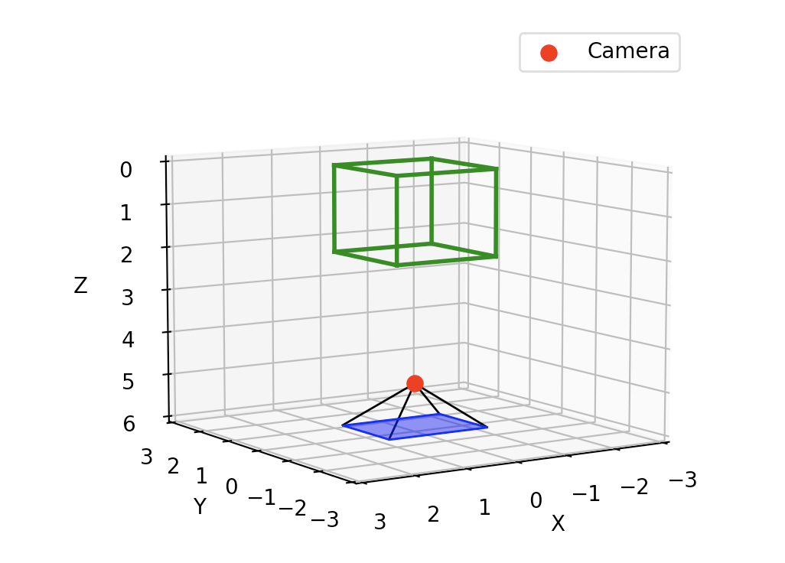
Data Extract
Blender
Projection Script
+ 180º on X axis

Slide 3
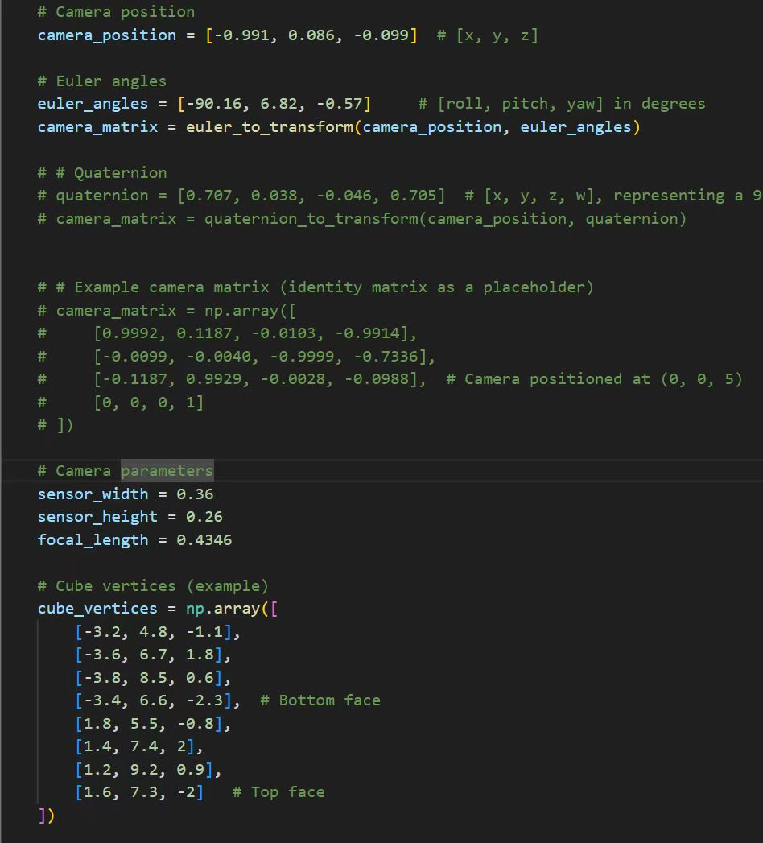
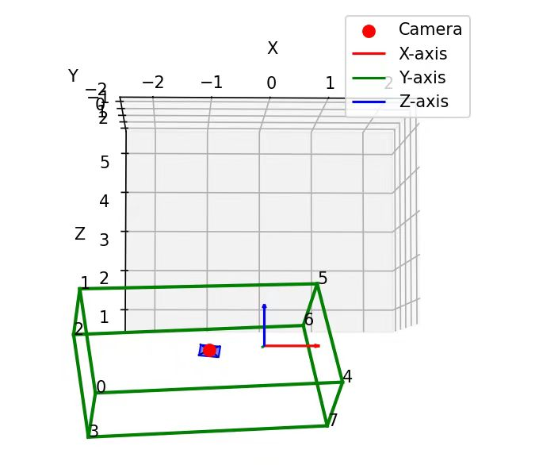
Data Extract

Slide 4
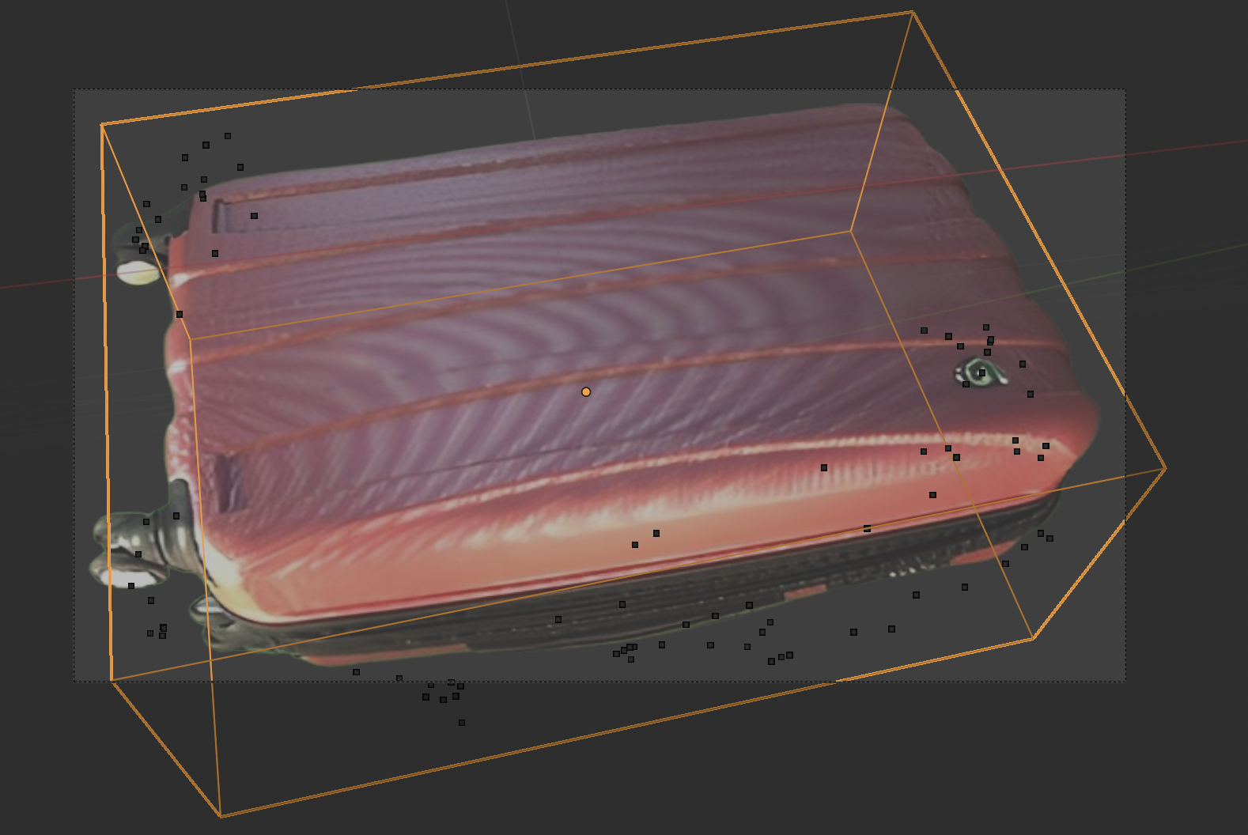
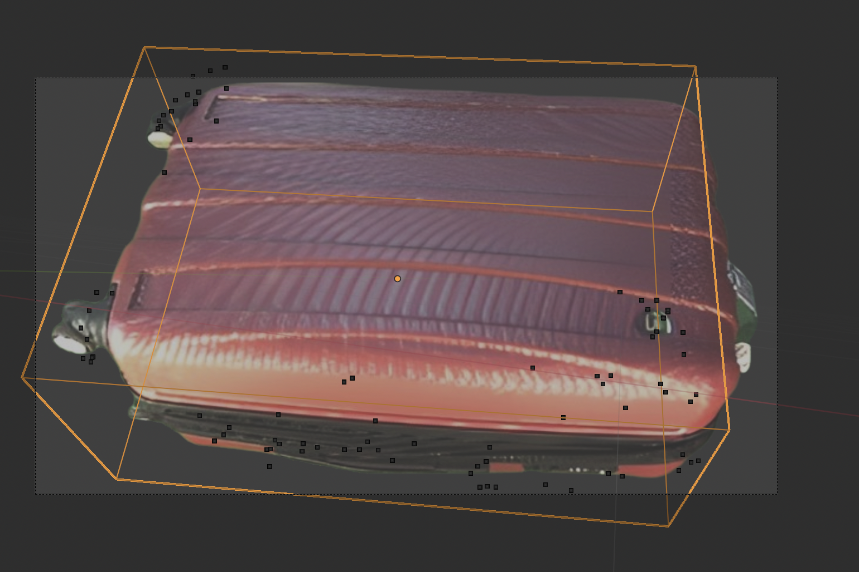
3d box on 2d images

Slide 5
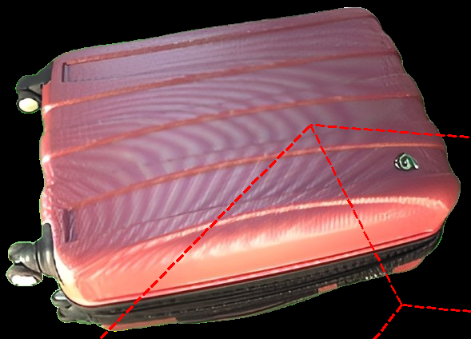
3d box on 2d images with mismatch.
Camera parameters
Camera Object: camxform_00000_1068303779_IDS_CAM1_2H_POS2__VI__1570032411-remo
matrix_world:
<Vector (0.9929, 0.1187, -0.0103, -0.9914)>
<Vector (-0.0099, -0.0040, -0.9999, -0.7336)>
<Vector (-0.1187, 0.9929, -0.0028, -0.0988)>
<Vector (0.0000, 0.0000, 0.0000, 1.0000)>
Lens (mm): 43.45584487915039
Sensor Width (mm): 36.0
Sensor Height (mm): 25.915109634399414
Sensor Fit: AUTO
Shift X/Y: 0.0, 0.0
Cube parameters
matrix_world:
<Vector (5.0157, -0.1758, -0.4260, -1.0002)>
<Vector (0.6896, 1.7728, 1.8849, 7.0103)>
<Vector (0.2888, -1.1789, 2.8980, -0.1064)>
<Vector (0.0000, 0.0000, 0.0000, 1.0000)>
Vertices (in world coords):
0: (-3.2070, 4.8367, -1.1104)
1: (-3.6331, 6.7216, 1.7876)
2: (-3.3829, 6.6095, -2.2893)
3: (-3.8089, 8.4944, 0.6087)
4: (1.8086, 5.5262, -0.8216)
5: (1.3826, 7.4111, 2.0764)
6: (1.6328, 7.2991, -2.0005)
7: (1.2067, 9.1839, 0.8975)

Slide 6
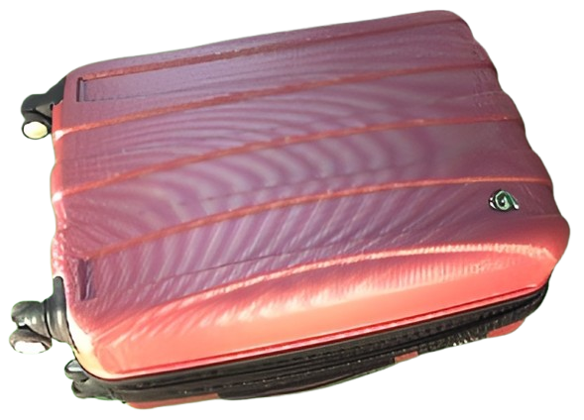
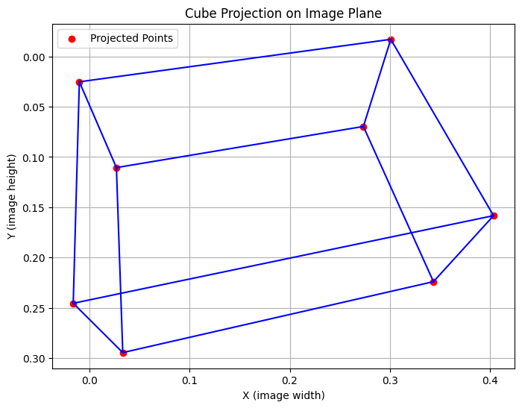
3d box on 2d images with mismatch.
Visualize the vertices of 3d in 2d space

Slide 7
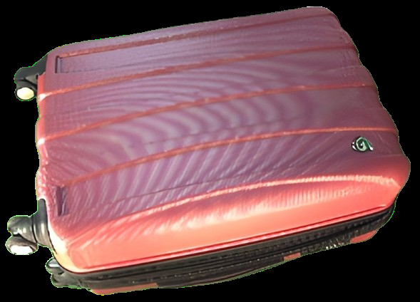
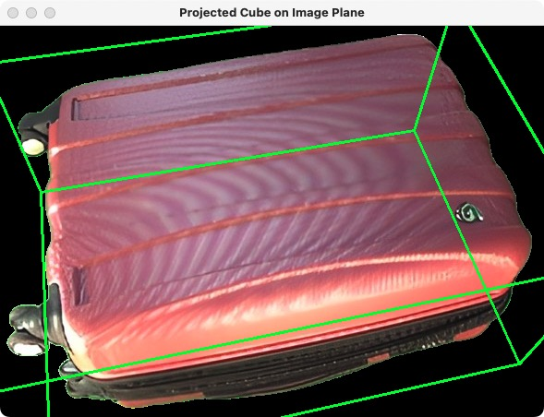
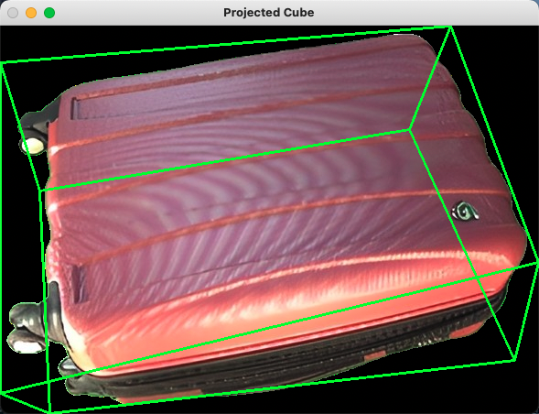
3d box on 2d images with mismatch.
Invisible
Computing the translations to pixels
Directly Place the lines overlaps with the images
With clips
No sensor_height, sensor_width required
No sensor_height, sensor_width required

